Slide 1
Creating a Database

Slide 2
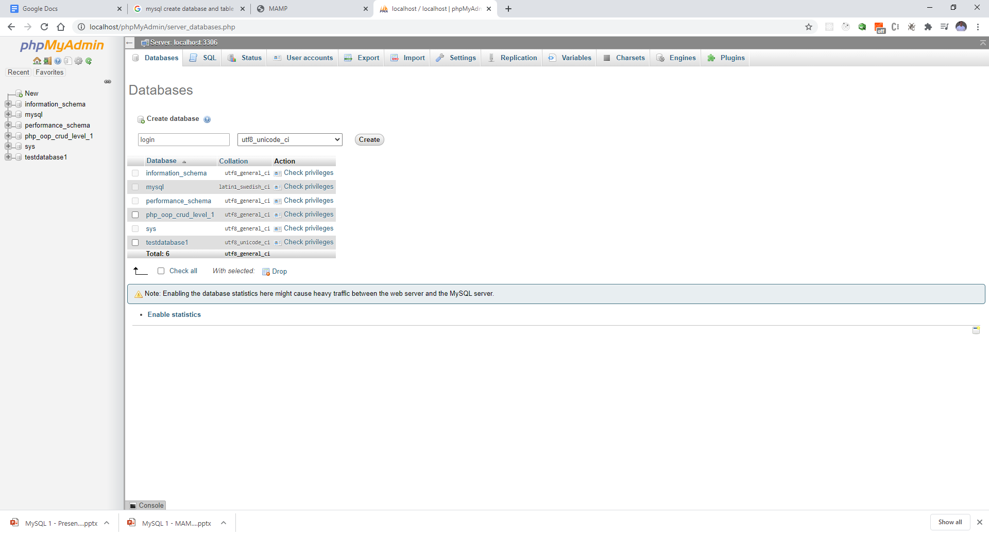
Step 1:

Slide 3
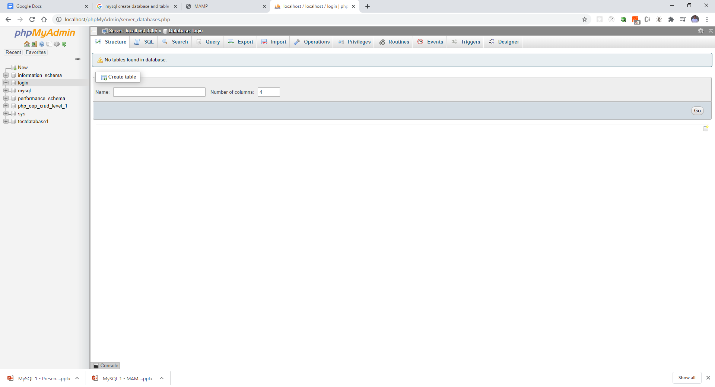
Now you need to create tables

Slide 4
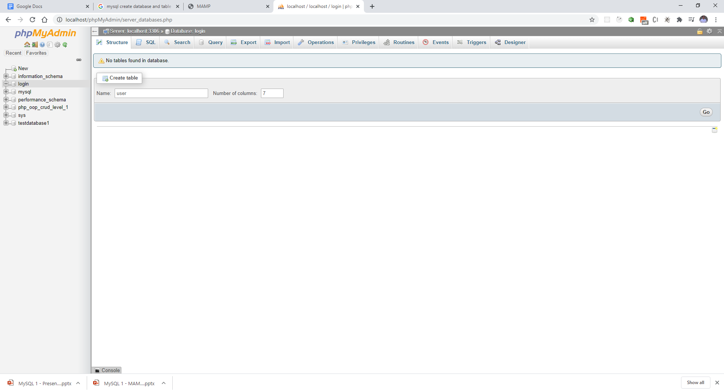
Give DB Name and Columns – then click GO

Slide 5
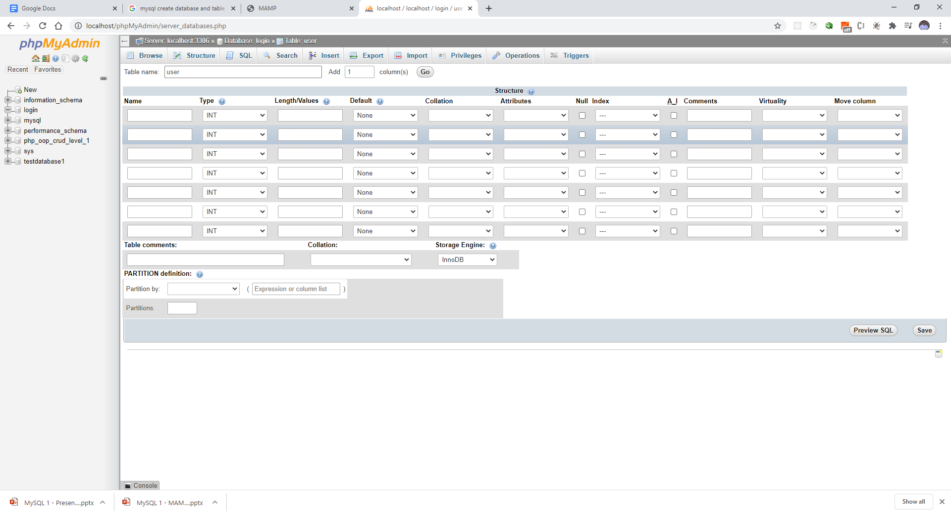
Database is created – prove columns

Slide 6
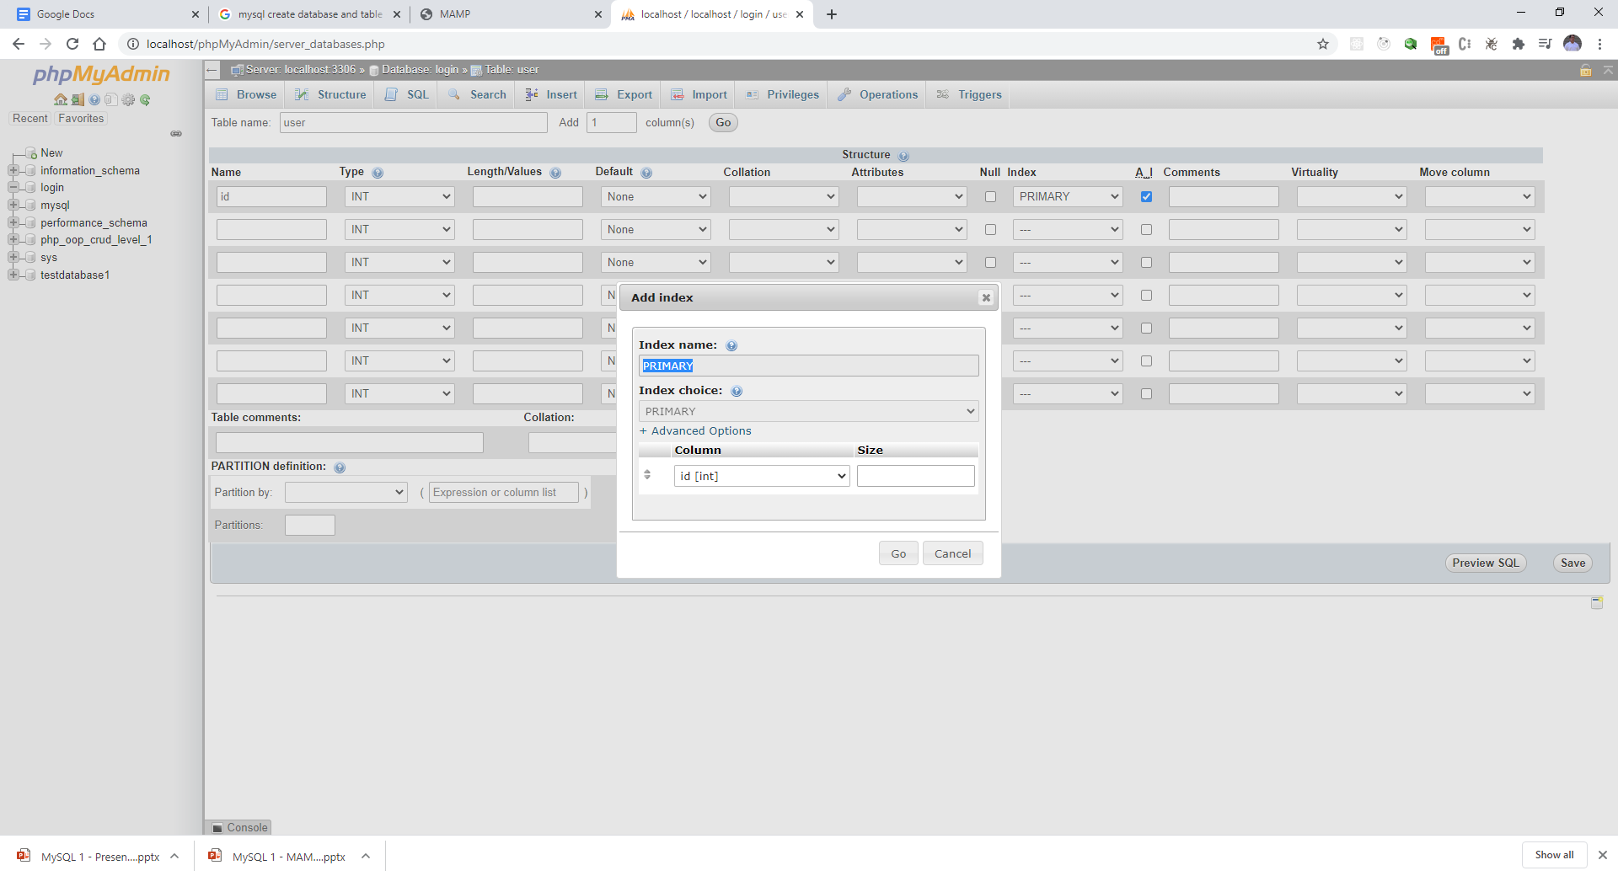
Create the first column – ID (primary key) Then hit GO

Slide 7
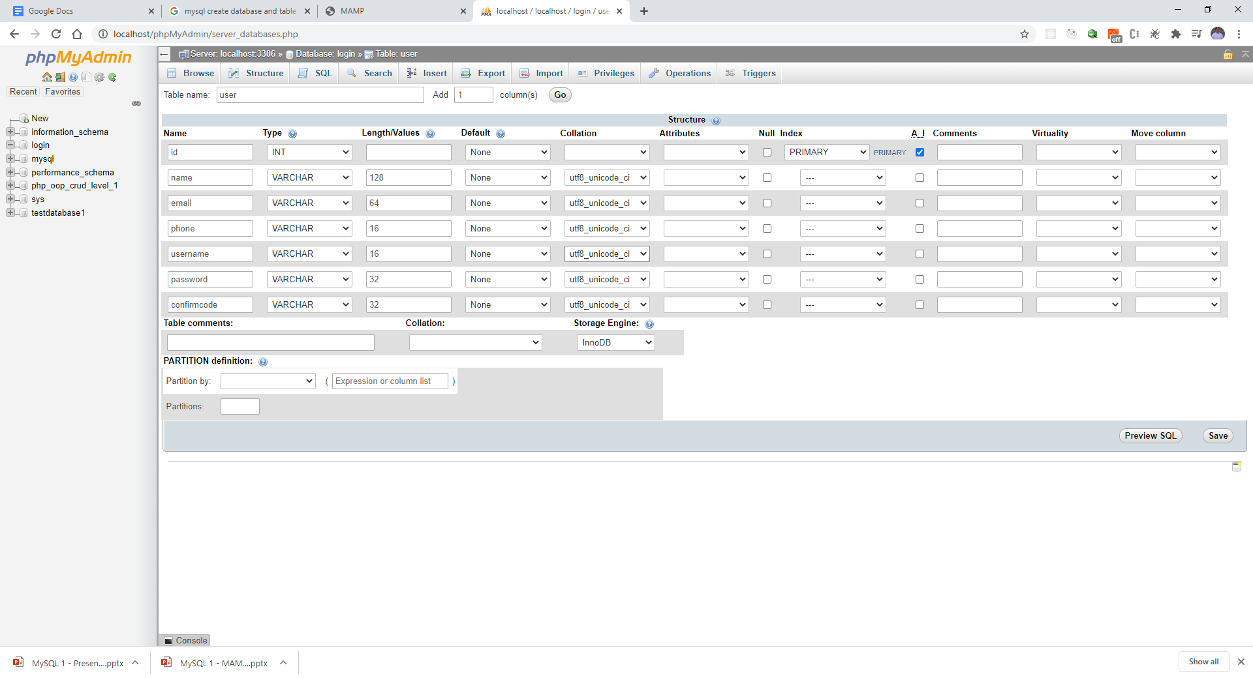
Finish the rest of the fields

Slide 8
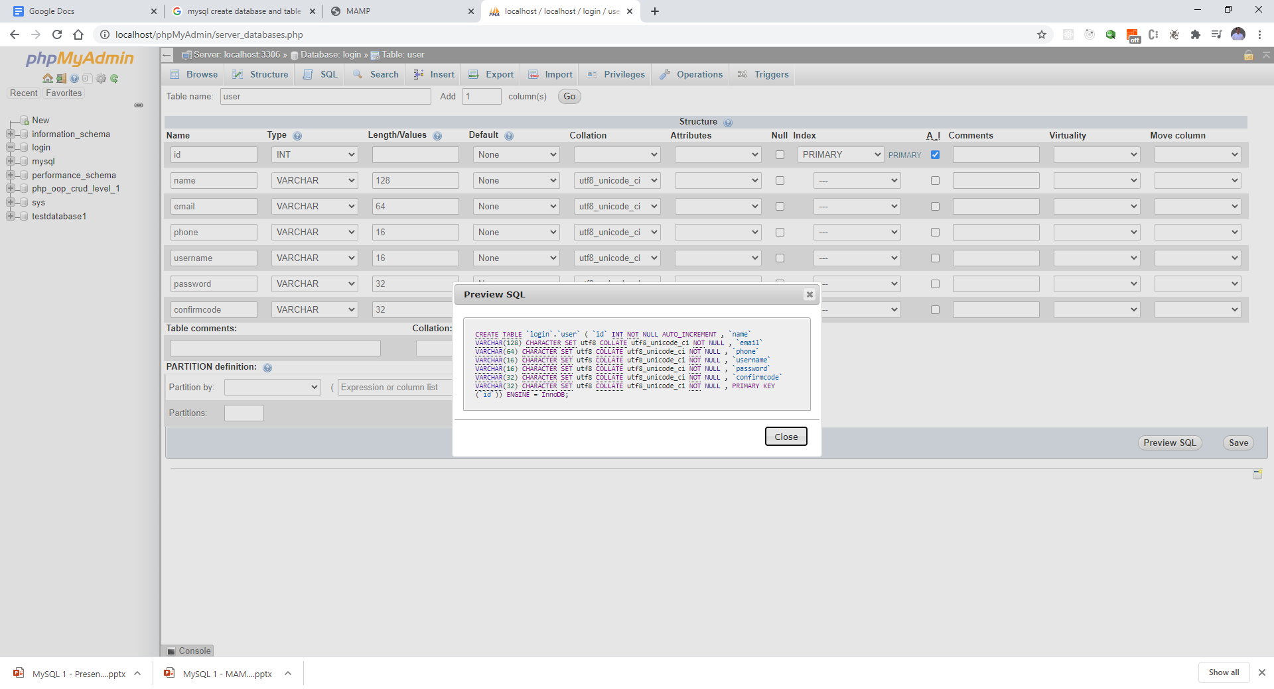
Preview your SQL

Slide 9
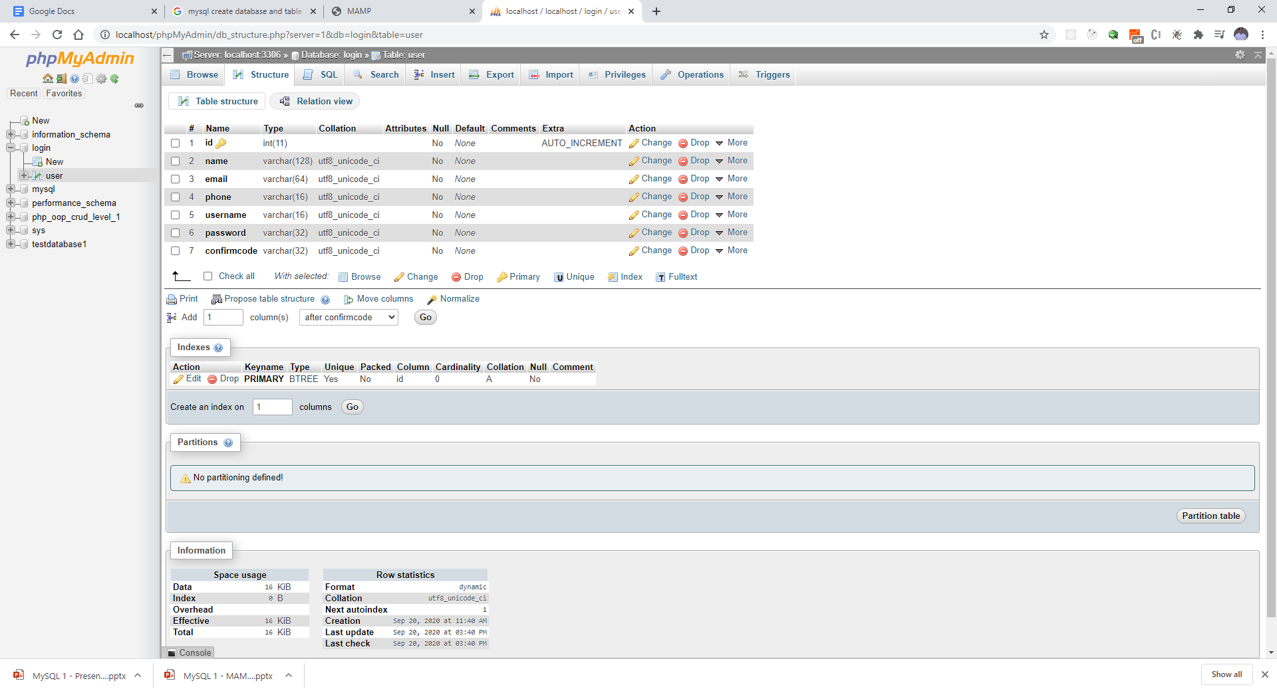
Click Save – Table will be

Slide 10
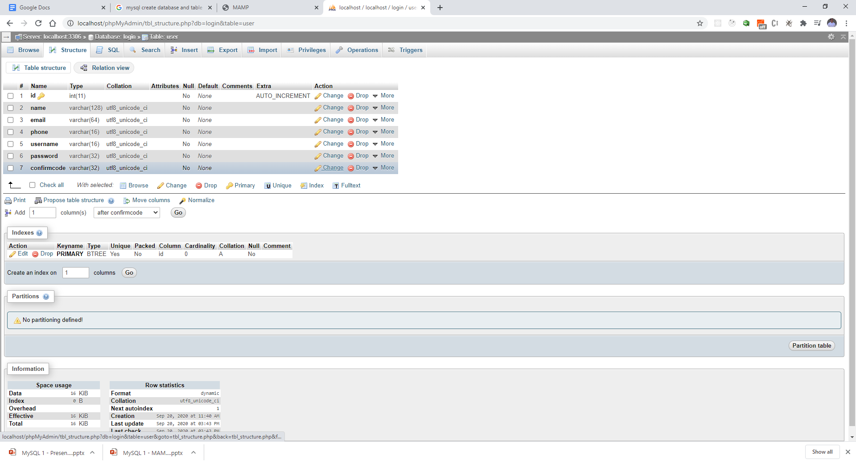
Change the Default to Null (from None) Hit Change

Slide 11
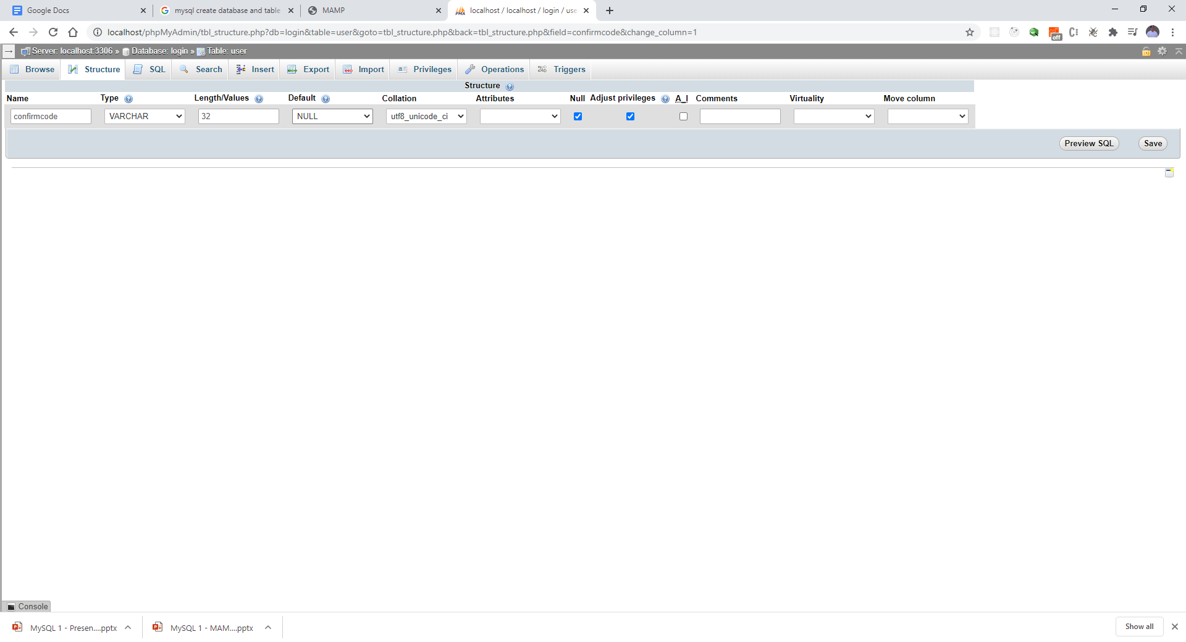
Change value to NULL and Save

